Slide 1
Growth and Master Facilities Plan
Board of Trustees - November 21, 2019

Slide 2
Strategic Plan goals
Strategy 5.1 - Staff will utilize various resources to support the financial, facilities, and technology goals of the strategic plan.
The District will maintain facilities in good repair
Create the Facilities Needs/Master Plan for long-term goals

Slide 3
Demographics

Slide 4
Enrollment Growth
Within 3 to 5 years
7,700 Residential Units now under review, approved, or under construction
Within 10 to 20 years
Up to 20,000 Residential Units
Concentrated in higher density residential growth areas in north and northeast (North Bayshore, East Whisman, Terra Bella, Moffett Field)
Additional 2,448 Students (K-8)
1,512 Elementary School, 936 Middle School

Slide 5
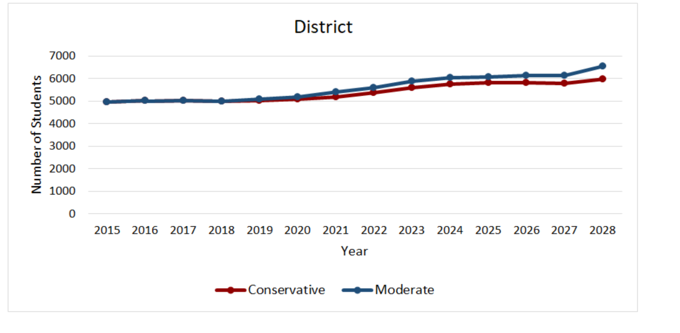
If growth stops today = 1,000 students
If residential growth stops today, there would still be a net increase of 1,000 additional students enrolled in MVWSD schools

Slide 6
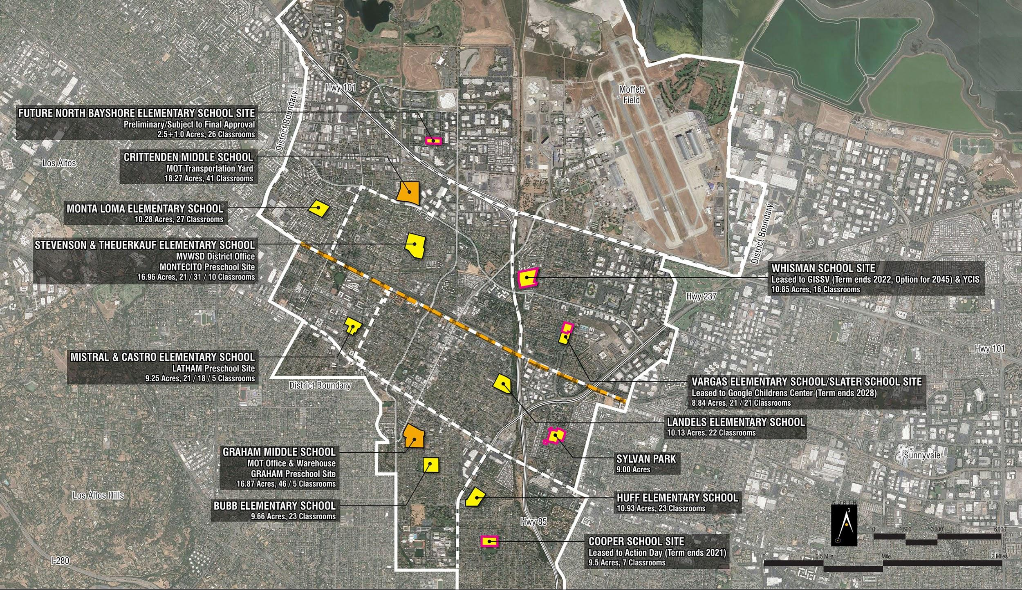
School sites

Slide 7
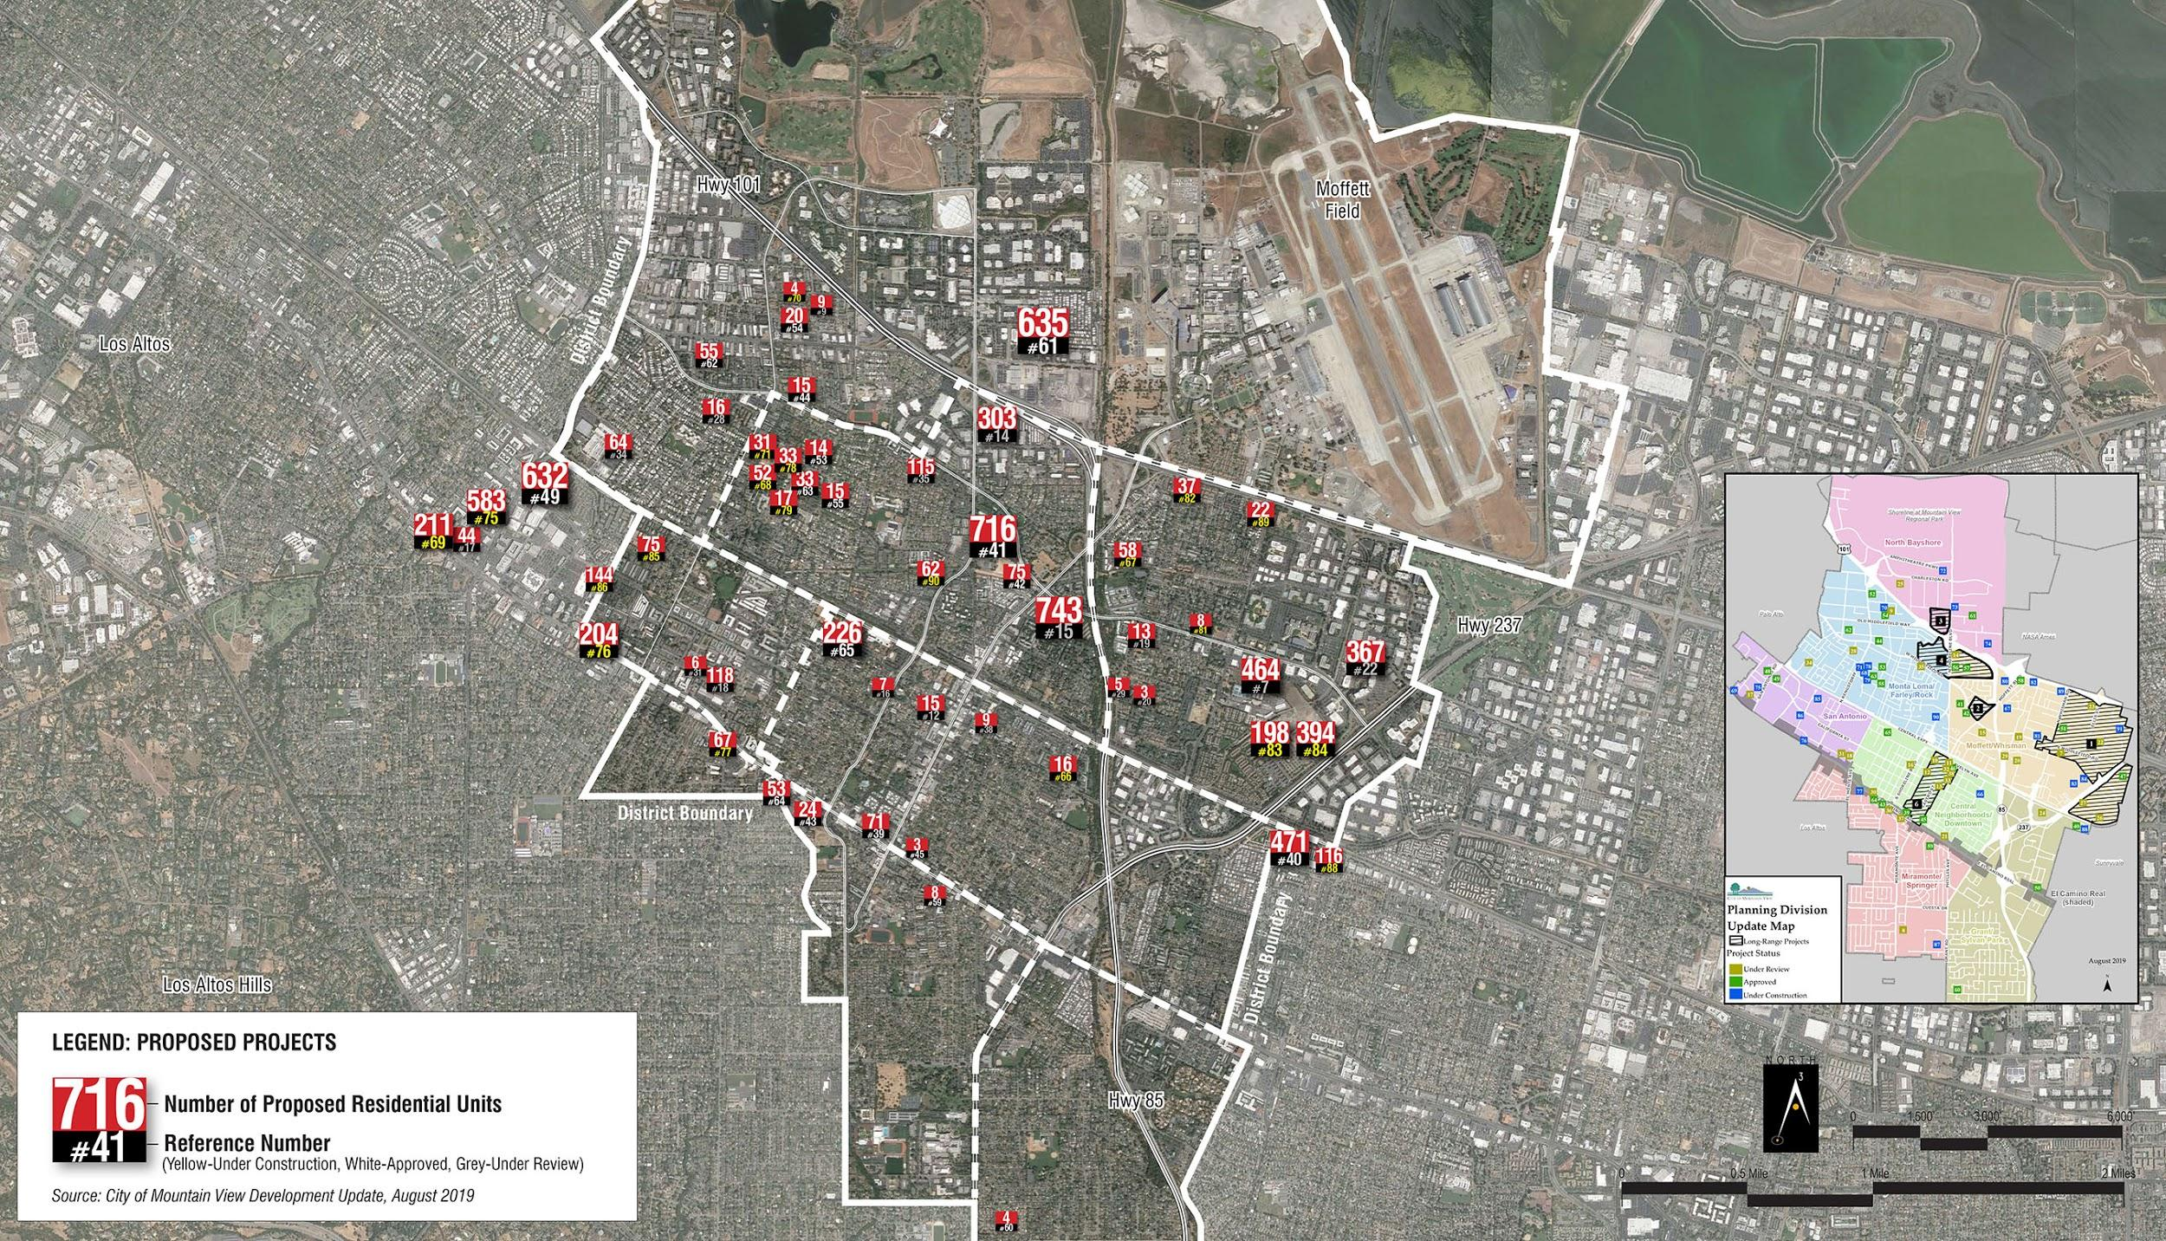
Future residential growth - all active locations
7,700 units currently under construction, approved or review

Slide 8
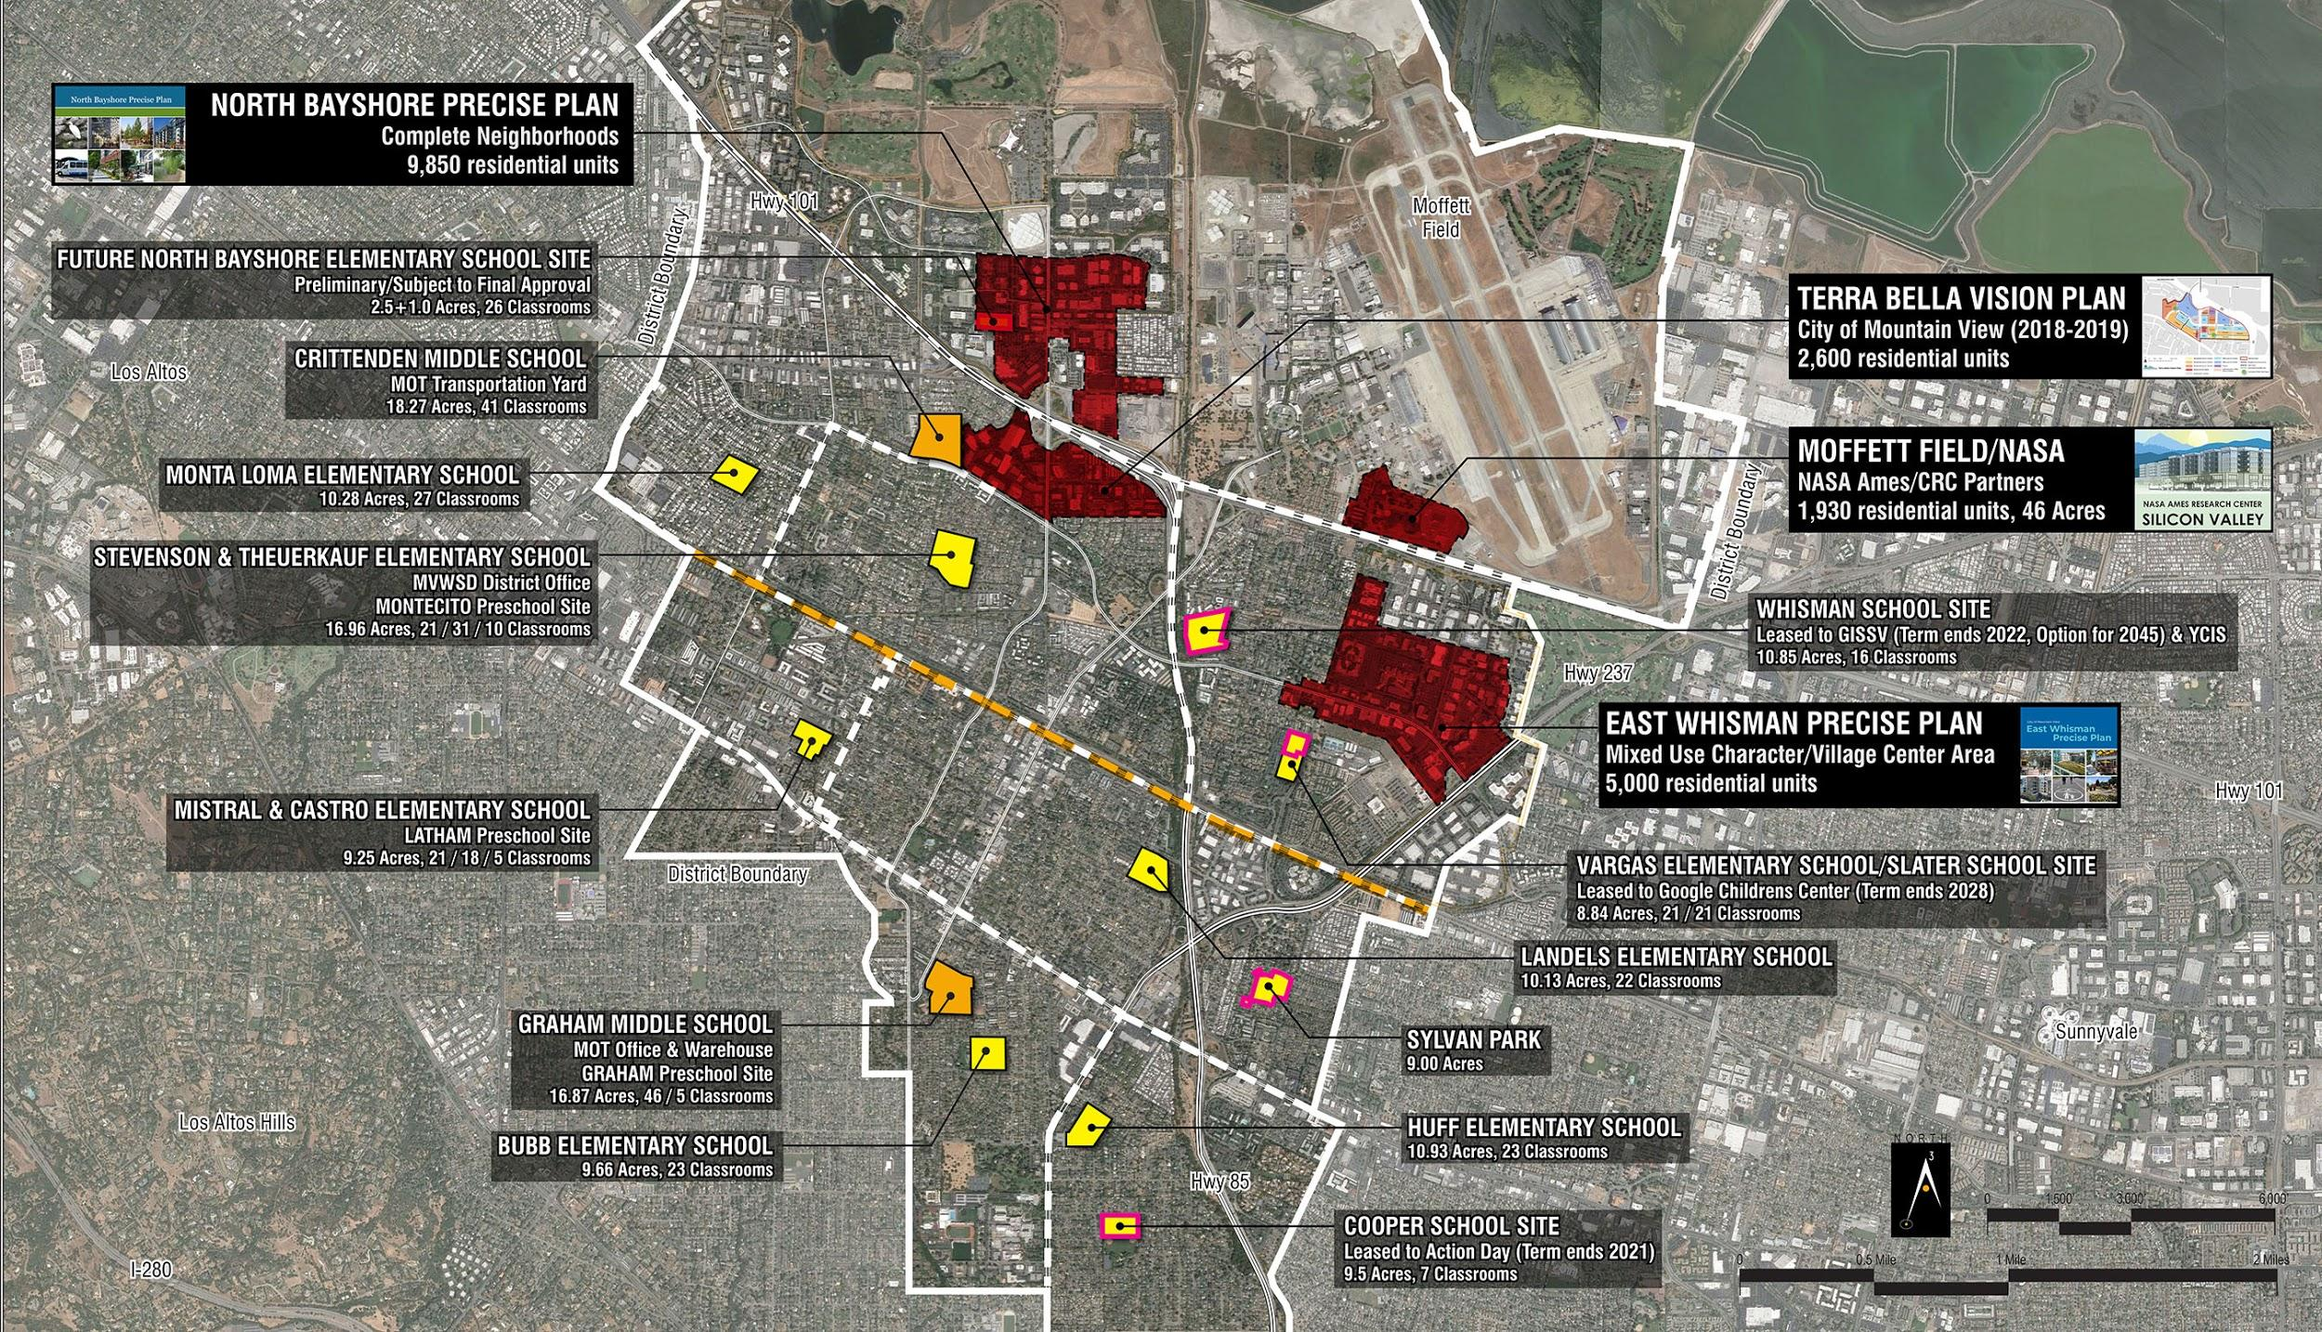
Future higher density residential growth areas

Slide 9
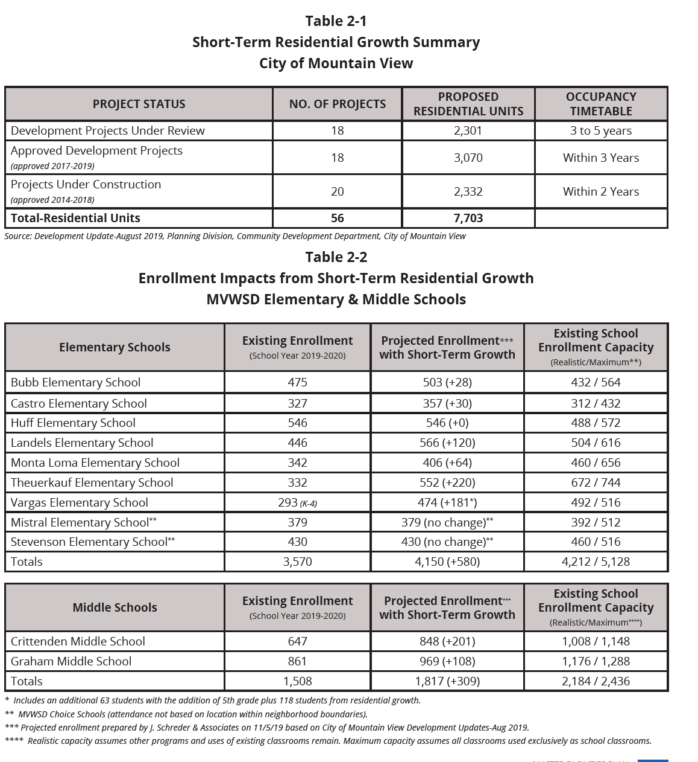

Slide 10
Impact on schools

Slide 11
Challenges-Enrollment Growth
Within 3 to 5 years
Existing capacity can absorb near-term growth
Within 10 to 20 years
Need capacity for 2+ Elementary Schools and 1,000 more Middle School seats
Density of existing schools varies
From 1.9 to 4.7 Classrooms/Acre
Growth concentrated in North/Northeast

Slide 12
Challenge 1- Growth Elementary School Level
Challenge 2- Growth Middle School Level
Potential solutions
New schools in North Bayshore & East Whisman
Reuse leased properties
Expand the capacity of existing schools
Grade-level schools
Lower & upper elementary schools (east Whisman)
Identify site for New Middle School
Recapitalize/redesign Graham & Crittenden
Convert all elementary schools to grade K-6

Slide 13
Feedback

Slide 14
Talked to parents, staff about challenges
Staff (all schools)
District Advisory Committee (districtwide), Mountain View Education Foundation (districtwide), PTA presidents (districtwide)
Principals’ coffees with parents (Bubb, Landels)
PTAs (Mistral, Graham, Vargas, Bubb, Theuerkauf, Monta Loma)
English Language Advisory Committees (Theuerkauf, Bubb, Graham, Landels, Huff)
School Site Council (Theuerkauf, Graham, Stevenson, Monta Loma)
Leadership Team

Slide 15
Central Themes that have emerged...
Strong themes: General
While not specific to potential growth solutions, a strong theme was parents would like to keep schools and classrooms small, with easy walking/biking access.
They also talked about their hope that density not be a diminishing factor for children’s school/recreational experiences.

Slide 16
Themes...
Strong theme: Specific to growth and facilities
Stakeholders are interested in long-term, flexible, and creative approaches to growth. Some of these may include hybrid models of the solutions proposed.

Slide 17
Exploring options

Slide 18
Facilities planning
Engaged with Artik on comprehensive Master Facilities Plan (MFP) to guide us for the next 10 years
MFP to be used as a resource document for District decisions
Plan includes:
Priority 1
Growth, Safety, Operational Efficiency
Priority 2
Outdoor Learning Spaces, Playgrounds, Utilities
Priority 3
Aesthetics, Signage
Priority 4
Reconfiguring Schools/Site Efficiencies

Slide 19
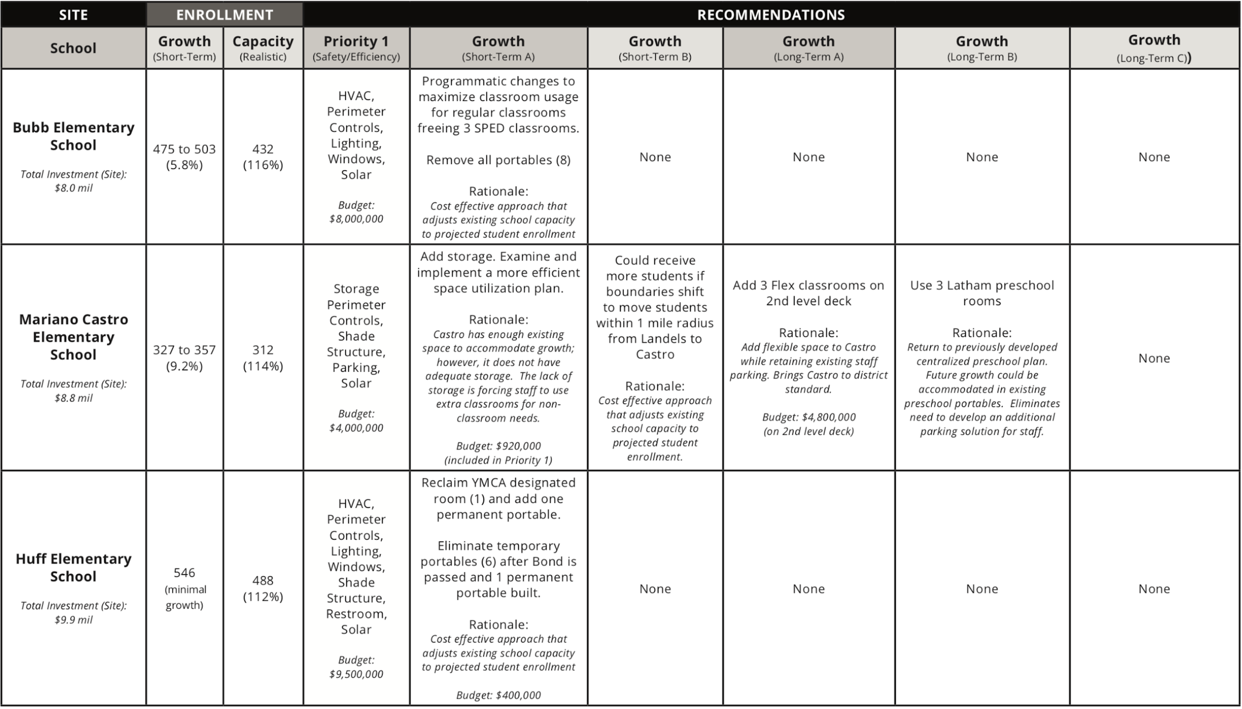
Options for addressing growth
Board feedback needed

Slide 20
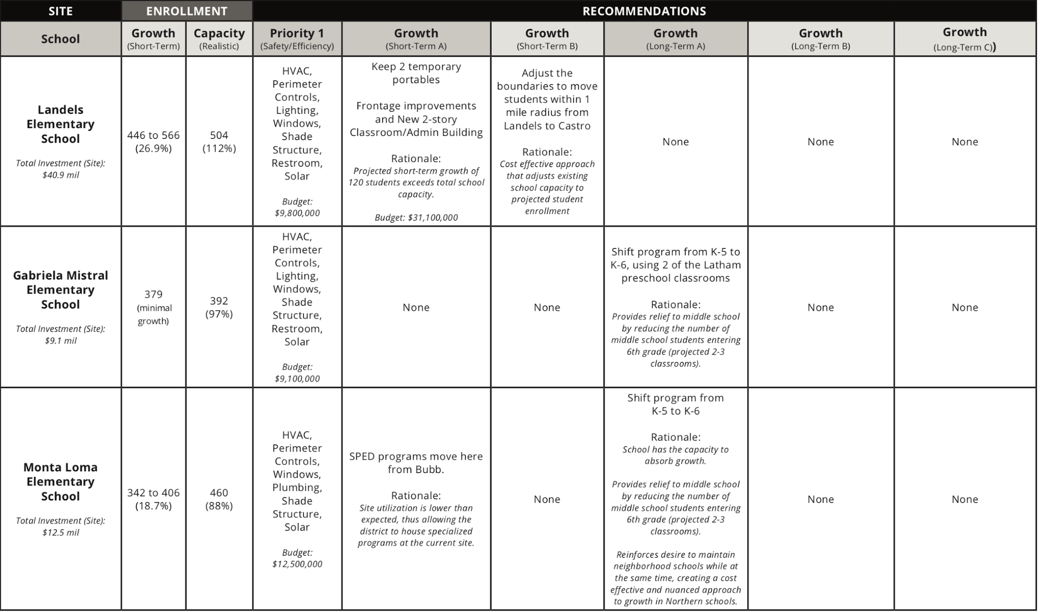
Options...

Slide 21
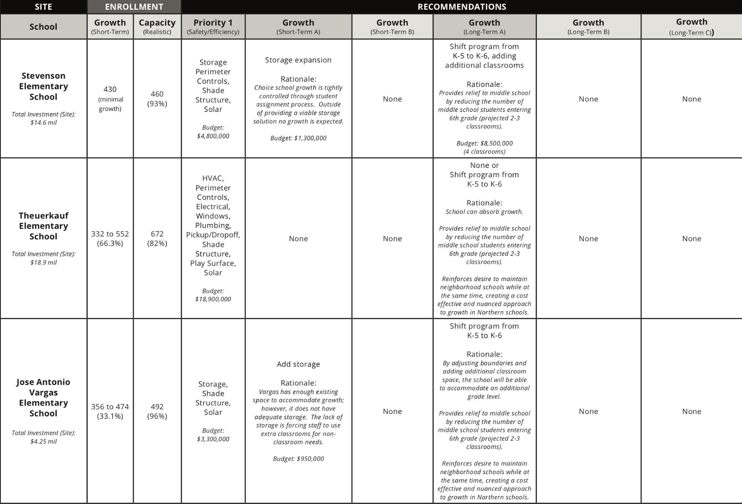
Options....

Slide 22
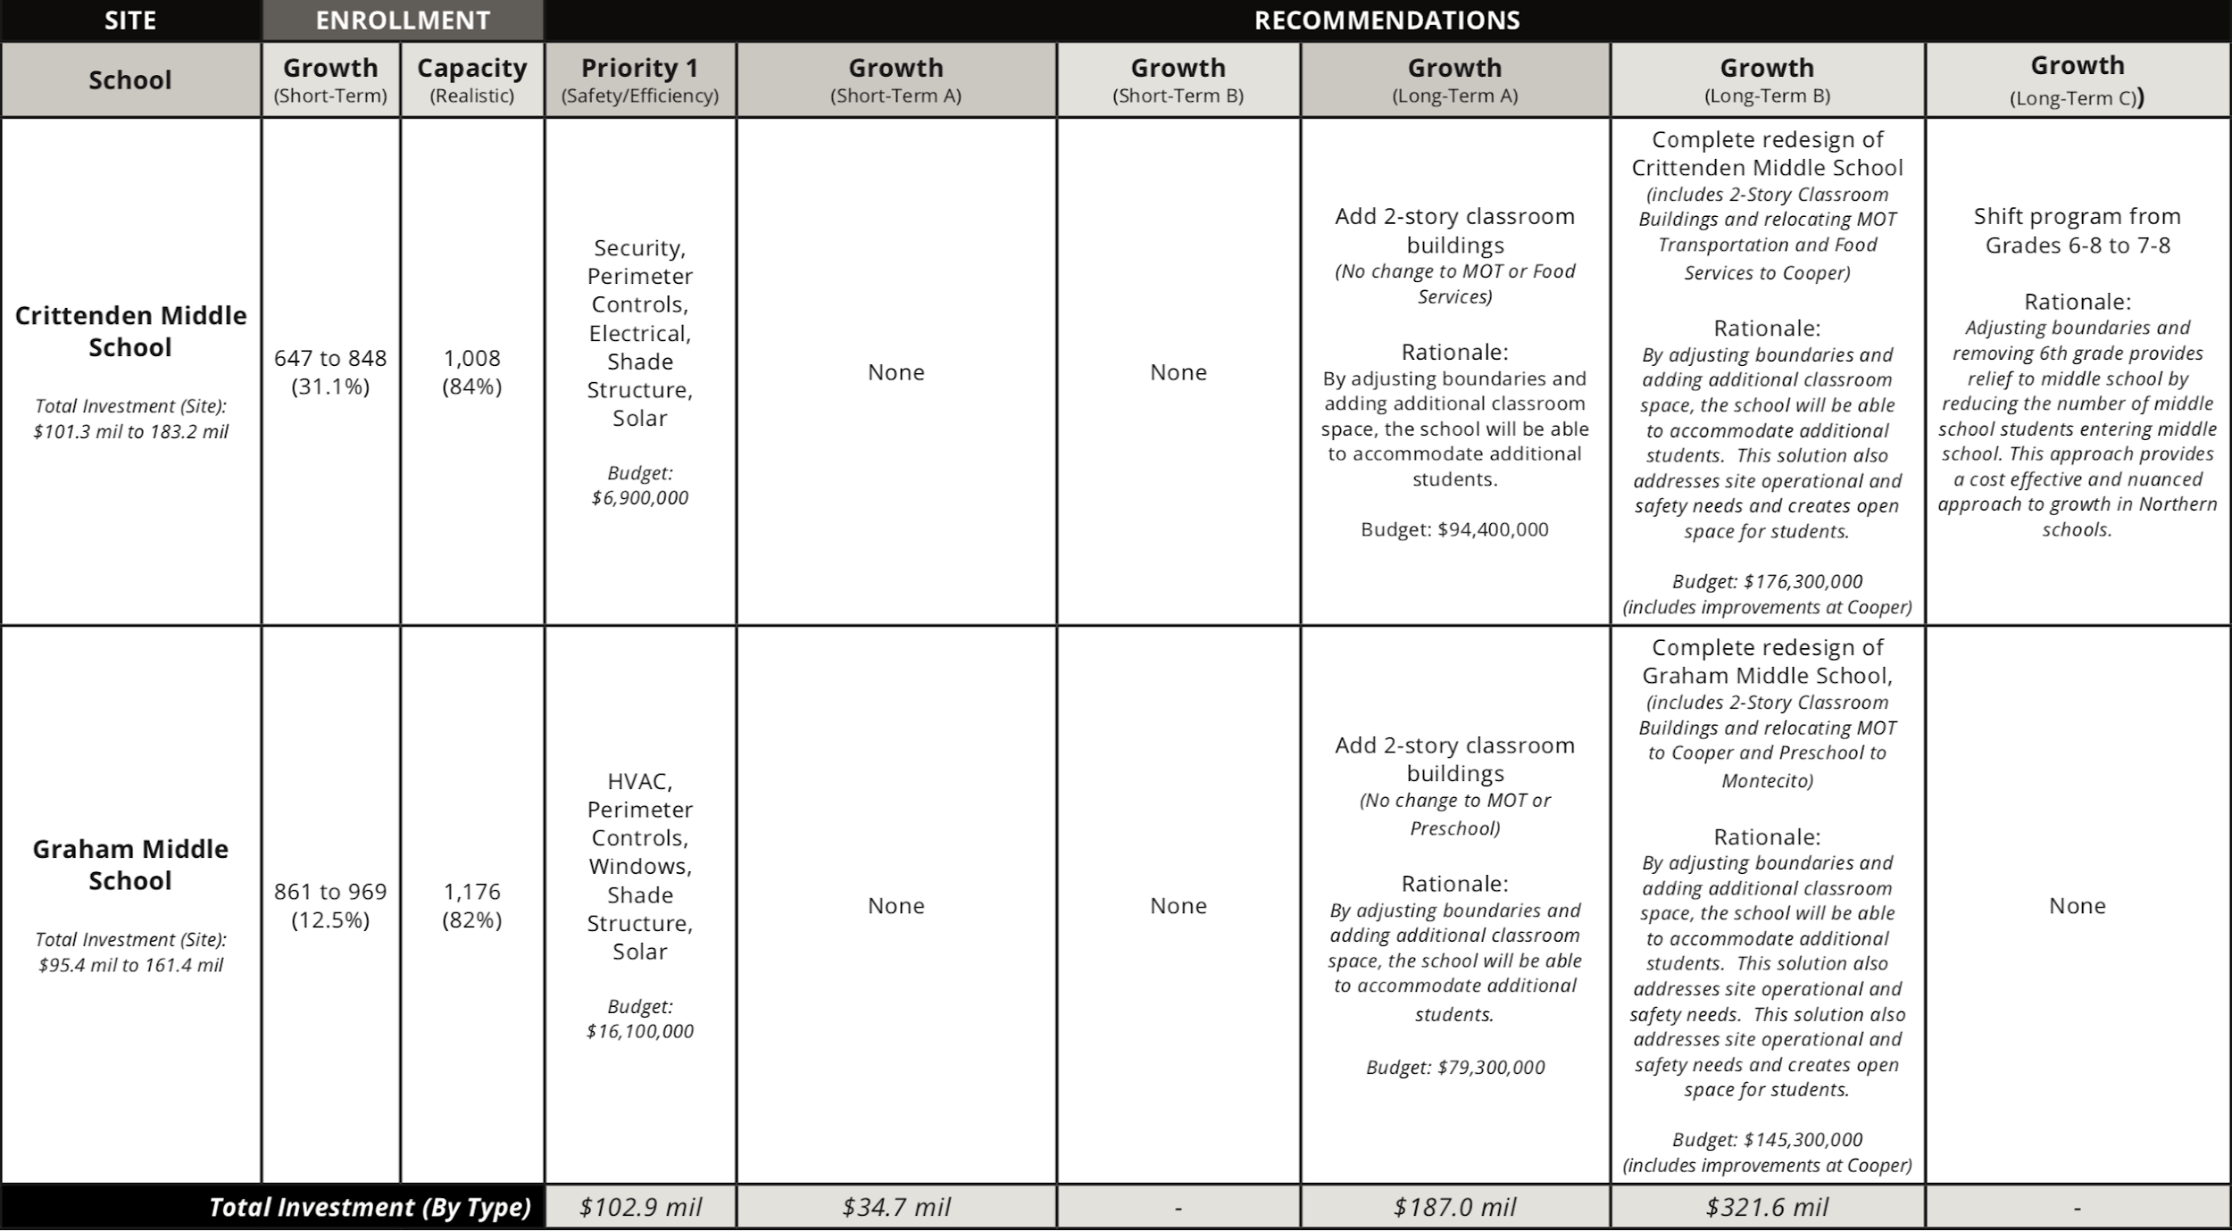
Options....

Slide 23
Challenge 1:
Themes and Recommendations

Slide 24
Feedback - Themes for Challenge 1
Growth at the Elementary level and the potential solutions
New schools in North Bayshore & East Whisman. Stakeholders expressed hope that this could be done through partnerships, reducing the cost to MVWSD.
Reuse leased properties. Stakeholders had questions about the cost of breaking leases vs. the cost of obtaining/building on new land.

Slide 25
Feedback - Themes...
Growth at the Elementary level and the potential solutions
Expand the capacity of existing schools (add 100 seats/4 classrooms at Bubb, Huff, Landels). Stakeholders were hesitant about this solution and expressed concerns about space being added to schools where the growth is not happening, ultimately resulting in increased traffic and possibility of redrawn boundaries. Also concerns about cost and quality of keeping current portables.
Grade-level schools and lower & upper elementary schools. Ranked as the least popular ideas with parents and staff members due to traffic concerns and fear of loss of school community.

Slide 26
Short-term growth
Recommendation 1:
Urban Elementary Schools models, which will house close to 700 students, require no less than 6 acres of land
Recommendation 2:
Addressing growth at Landels is a priority 1 project
Recommendation 3:
Implement inclusive special education model, co-taught classes, at Bubb (programmatic changes) to address the need for additional space

Slide 27
Short-term growth
Recommendation 4:
To increase building usage efficiency, storage must be added to Castro, Stevenson, and Vargas to free up classrooms
Recommendation 5:
Add one additional permanent portable to Huff elementary to accommodate current student enrollment
Recommendation 6:
Where needed revisit full-day YMCA portable rental/usage
Recommendation 7:
Adjust boundaries as needed to respond to growth

Slide 28
Challenge 2:
Themes and Recommendations

Slide 29
Feedback - Themes for Challenge 2
Growth at the middle school level and potential solutions
Identify site for New Middle School. Stakeholders expressed hope that this could be done through partnerships, reducing cost to MVWSD.
Recapitalize/redesign Graham & Crittenden. Stakeholders expressed support, but are concerned about traffic and student experience (both academic and extracurricular) as these schools grow.

Slide 30
Feedback - Themes...
Growth at the middle school level and potential solutions
Convert all elementary schools to K-6. Ranked as the least popular ideas with parents and staff members, though stakeholders offered a mix of opinions. (Pros: 6th graders could be leaders, middle schools would be smaller and lead to more supervision/support for 7th/8th graders. Cons: negative reviews from Los Altos 6th graders in elementary, and less access to middle school curriculum and math differentiation if in elementary.) Some stakeholders are marginally supportive of this idea if that means growth is solved without renovating or adding to middle schools.

Slide 31
Long-term growth recommendations
Recommendation 1:
Spend more time engaging the community on the feasibility of various options:
K-6 schools
Larger middle schools
Recommendation 2:
Continue to explore the viability of additional sites
Middle school, North Bayshore, East Whisman, and possibly Terra Bella.
Recommendation 3:
Develop a plan to consolidate various programs/services
Preschool, Transportation, Food Services, Maintenance

Slide 32
Next steps

Slide 33
Tasks ahead
Finalize MFP on December 12
Board of Trustees decide on a $259 million bond issue for March 3 ballot to raise capital for facilities
Continue the conversation with all stakeholders
Ongoing land negotiations in high growth areas
New school properties in North Bayshore & East Whisman

Slide 34
Feedback from Board
Themes and Recommendations

Slide 35
Recommendations
Staff welcomes feedback and questions around the seven short-term and three long-term recommendations
Staff is recommending that the Board approve the short-term recommendations in totality, in order to address the short-term growth needs (3-5 years).
Additionally, staff is recommending that the Board approve that staff allocates resources and time to further engage the community on the feasibility of the three long-term solutions.

Slide 36
Short-term growth
Recommendation 1:
Urban Elementary Schools models, which will house close to 700 students, require no less than 6 acres of land
Recommendation 2:
Addressing growth at Landels is a priority 1 project
Recommendation 3:
Implement inclusive special education model, co-taught classes, at Bubb (programmatic changes) to address the need for additional space

Slide 37
Short-term growth
Recommendation 4:
To increase building usage efficiency, storage must be added to Castro, Stevenson, and Vargas to free up classrooms
Recommendation 5:
Add one additional permanent portable to Huff elementary to accommodate current student enrollment
Recommendation 6:
Where needed revisit full-day YMCA portable rental/usage
Recommendation 7:
Adjust boundaries as needed to respond to growth

Slide 38
Long-term growth recommendations
Recommendation 1:
Spend more time engaging the community on the feasibility of various options:
K-6 schools
Larger middle schools
Recommendation 2:
Continue to explore the viability of additional sites
Third middle school, North Bayshore, East Whisman, and possibly Terra Bella.
Recommendation 3:
Develop a plan to consolidate various programs/services
Preschool, Transportation, Food Services, Maintenance

